Slide 1
Lab 5: 1D spatial models with unequal distances
April 26, 2018

Slide 2

Coastline (sites are blue circles)
Imagine that:
$$c_{s}\left(i\right)\sim g\left(μ_{s}\right)$$
Where $c_{s}(i)$ is a count sample for site s and replicate i
where g is the observation distribution and $μ_{s}$ is the expected value
You have three density samples per site
Strategies:
Blocking (fixed or random)
Equal-distance autoregression
Unequal-distance autoregression
Notes:
Whitenoise has equal power over uniform set of frequencies—variance with small scale and broad scale correlated patterns is about the same
Many biological processes have a spectrum—variance varies by scale
Characteristic “power frequency” function
With equal space sampling you can’t look at variation on scales less than the distance between sampling points
eg California bite biological processes water temp at scale of eddy = 10-100 miles, upwelling, bathymetry
Sample at small scales—what proportion of correlation decouples quickly
Parametric correlation function estiamtes dominate mode

Slide 3
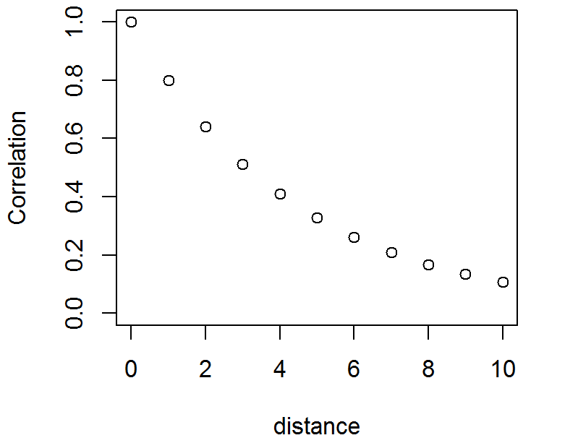

Review: Equal distance autoregression
$$c(s)\sim g\left(μ(s)\right)$$
$$μ\left(s\right)=x(s)β+ε(s)$$
Let’s assume first-order autoregression:
$$ε(s+1)\sim Normal(ρε(s),(1−ρ^{2})σ_{ε}^{2})$$
Notes:
Snap all locations to an equal grid
Marginal variance of this process is sigma2_e

Slide 4
What if you want to model unequal distances?

Slide 5
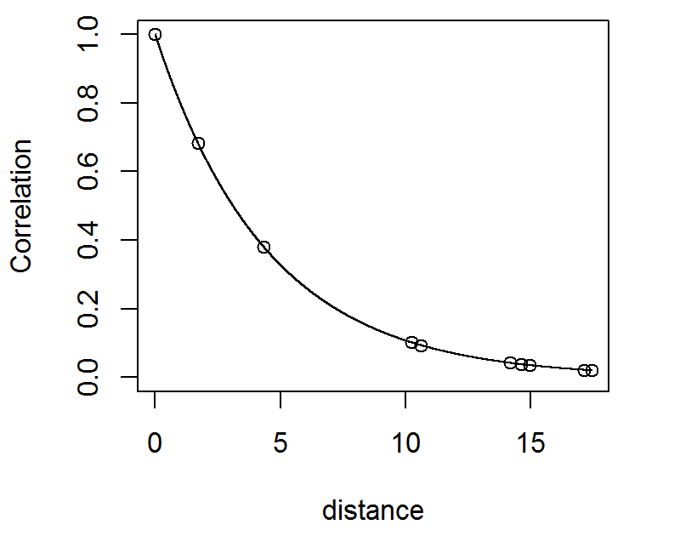
What if you want to model unequal distances?

Slide 6
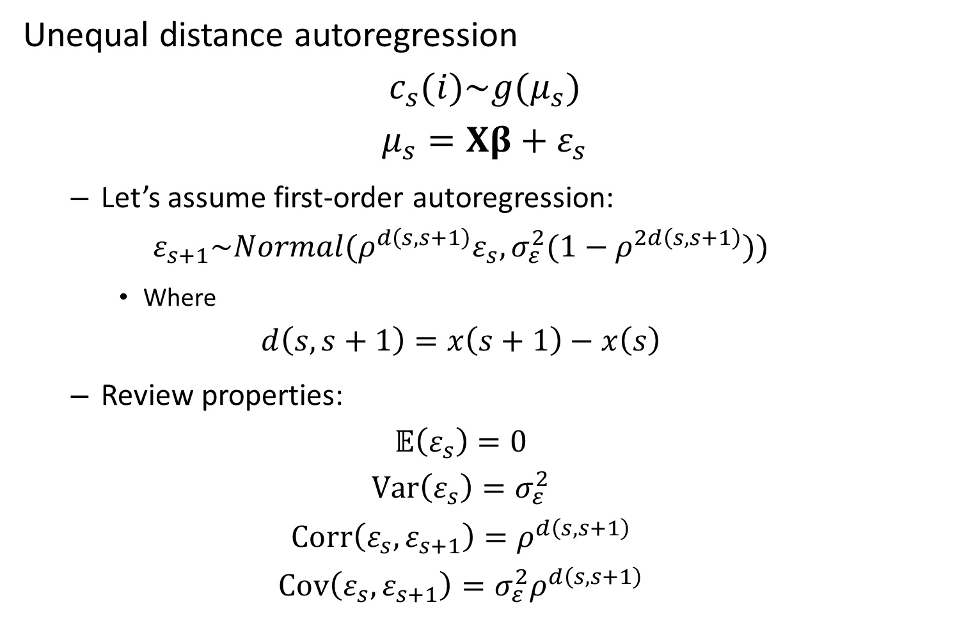
Unequal distance autoregression
$$c_{s}(i)\sim g(μ_{s})$$
$$μ_{s}=Xβ+ε_{s}$$
Let’s assume first-order autoregression:
$$ε_{s+1}\sim Normal(ρ^{d\left(s,s+1\right)}ε_{s},σ_{ε}^{2}(1−ρ^{2d\left(s,s+1\right)}))$$
Where
$$d\left(s,s+1\right)=x\left(s+1\right)−x\left(s\right)$$
Review properties:
$$𝔼\left(ε_{s}\right)=0$$
$$Var\left(ε_{s}\right)=σ_{ε}^{2}$$
$$Corr\left(ε_{s},ε_{s+1}\right)=ρ^{d\left(s,s+1\right)}$$
$$Cov\left(ε_{s},ε_{s+1}\right)=σ_{ε}^{2}ρ^{d\left(s,s+1\right)}$$
Notes:
Extend first order autoregressive to non-equally spaced
By doing rho to the power of distance between sites
d() is the distance
For variance, if dist is zero, sites are perfectly correlated (no variance)
And as distance goes to infinity, rho to power goes to 0 because
0 < rho < 1
So it goes to the sill of sigma squared
Iter: 1 for inner optimizer. Ustep: 1 is a good sign because the newton step gets really bad if the inner likelihood is not quadratic. Gets smaller if tmb detects that likelihood is NOT quadratic = struggles

Slide 7
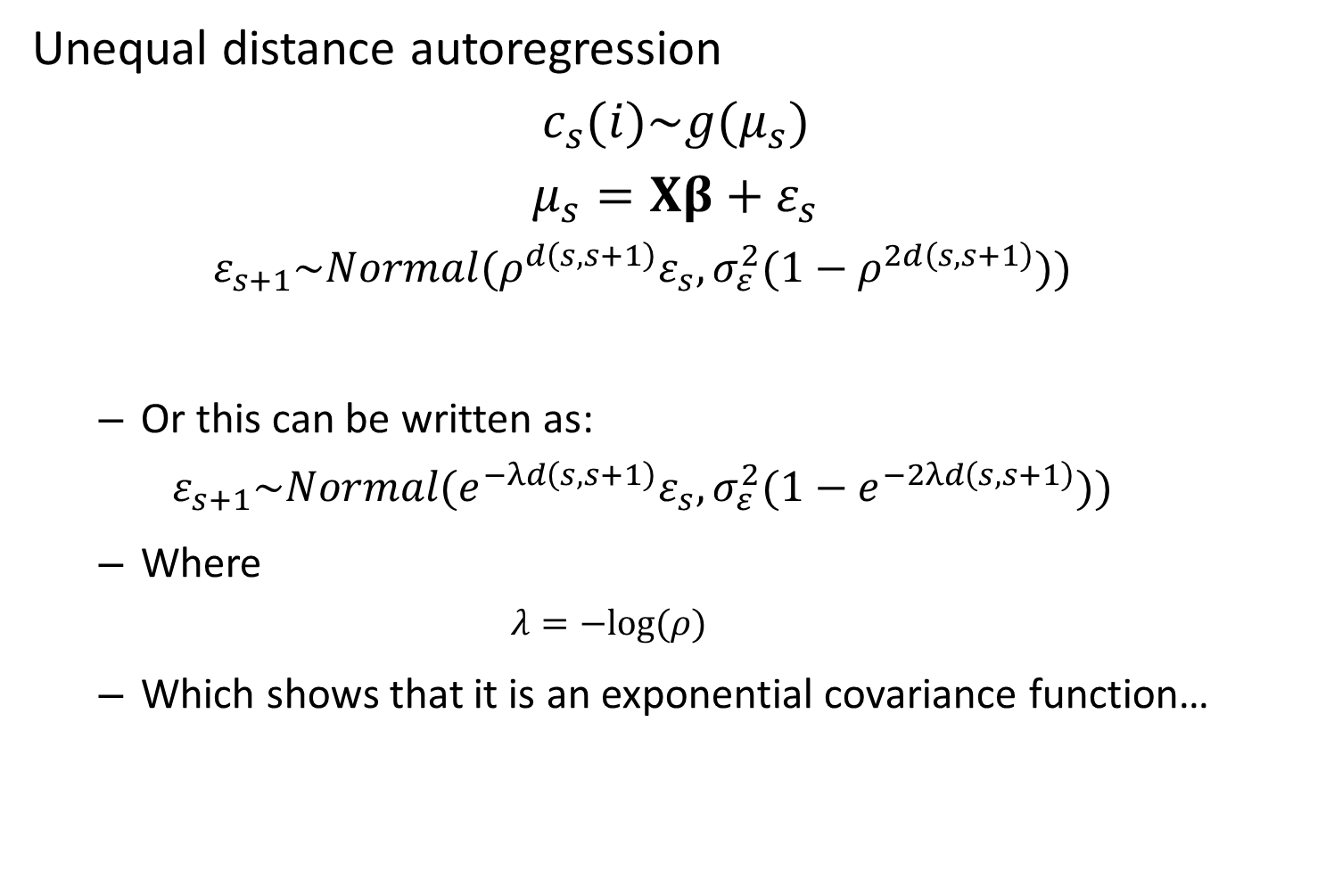
Unequal distance autoregression
$$c_{s}(i)\sim g(μ_{s})$$
$$μ_{s}=Xβ+ε_{s}$$
$$ε_{s+1}\sim Normal(ρ^{d\left(s,s+1\right)}ε_{s},σ_{ε}^{2}(1−ρ^{2d\left(s,s+1\right)}))$$
Or this can be written as:
$$ε_{s+1}\sim Normal(e^{−λd\left(s,s+1\right)}ε_{s},σ_{ε}^{2}(1−e^{−2λd\left(s,s+1\right)}))$$
Where
$$λ=−log⁡(ρ)$$
Which shows that it is an exponential covariance function…
Notes:
Change of variables—new param lambda is the decorrelation rate
1:1 mapping of AR1 process and exponential cov fxn for correlated model
Mean reverting Kalman filter like an exponential covariance function (they are the same)

Slide 8

Unequal distance autoregression
$$c_{s}(i)\sim g(μ_{s})$$
$$μ_{s}=Xβ+ε_{s}$$
Then…
$$ε\sim MVN(0,Σ)$$
where
Notes:
Instead of defining the probabilities recursively, we can define the joint probs using mvn with covariance function we had written before

Slide 9
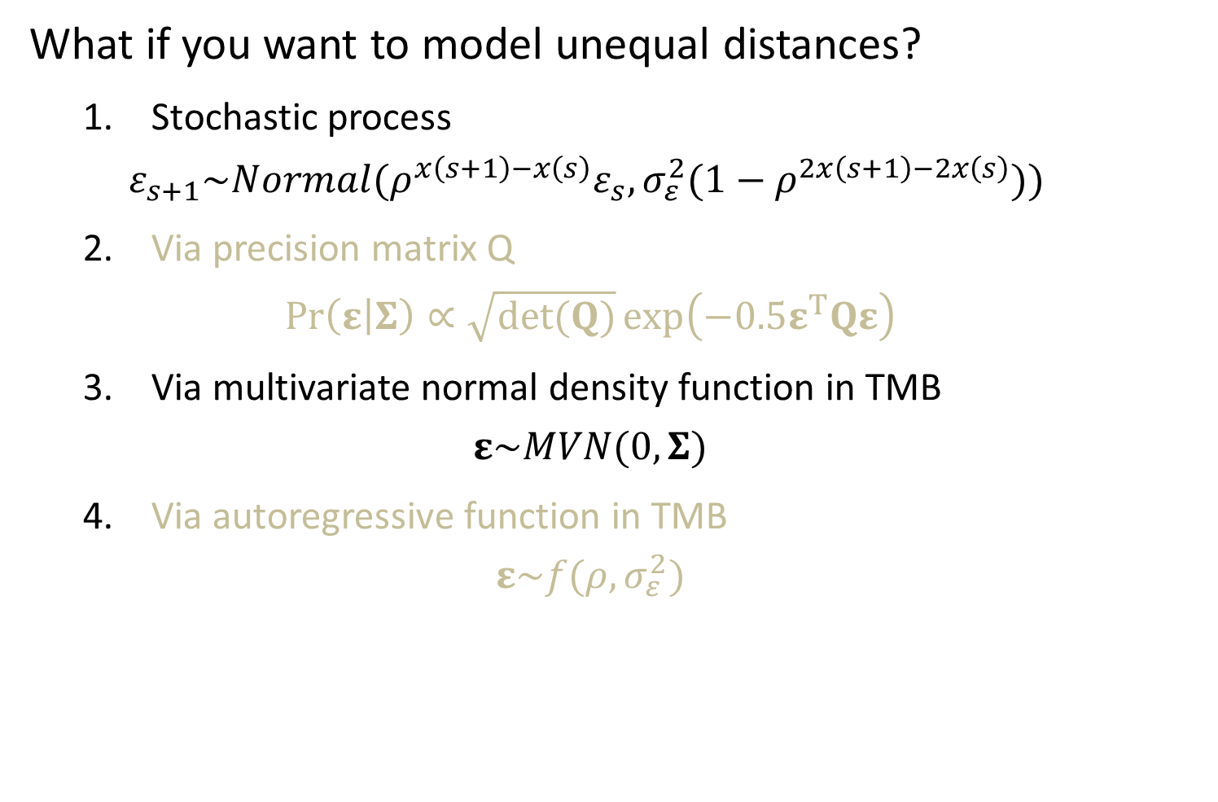
What if you want to model unequal distances?
1. Stochastic process
$$ε_{s+1}\sim Normal(ρ^{x\left(s+1\right)−x\left(s\right)}ε_{s},σ_{ε}^{2}(1−ρ^{2x\left(s+1\right)−2x\left(s\right)}))$$
2. Via precision matrix Q
$$\operatorname{Pr}\left(ε | Σ\right)∝\sqrt{det(Q)}\exp\left(−0.5ε^{T}Qε\right)$$
3. Via multivariate normal density function in TMB
$$ε\sim MVN(0,Σ)$$
4. Via autoregressive function in TMB
$$ε\sim f(ρ,σ_{ε}^{2})$$
Notes:
From last time, 4 different ways to code the model (all separable in theory, but maybe not in practice)
Two issues
Separability
multiple ways to parameterize the same model

Slide 10
[Show R and TMB code for 2 ways to code this]
Notes:
How common are boundary issues?
Next week SPDE has boundary issues…deal with by putting boundaries really far away using random effects with no data
Define joint prob of all random effects, or decompose them into conditional probs
[ ] go through and look at how covariances are being calculated…
Simulatign
Assemble who cov mat and use dmvnorm
Cholesky decomp and generate vector of iid normal and multiply to transform
Eigenvalue decomp
More on the Cholesky decomposition
Joint vs conditional for models
Epsilon ~ MVN (joint)
delta~ iid Normal then multiply by Cholesky (conditional)
Cholesky is lower triangular matrix, with upper triangle = 0
First element of epsilon is just delta*Cholesky, which has one element
Next row has two, and so on
So Cholesky matrix is a way of encoding the recursive relationship in linear algebra format

Slide 11

Replace $ρ^{\left\{d\left(s_{1}−s_{2}\right)\right\}}$
With $σ^{2}exp⁡(−\frac{s_{1}−s_{2}}{ρ})$
One version of matern https://en.wikipedia.org/wiki/Mat%C3%A9rn_covariance_function
Notes:
Instead of defining the probabilities recursively, we can define the joint probs using mvn with covariance function we had written before
Results:
Matern and other correlation functions are no longer first order markov, so the hessian is more dense

Slide 12
Lessons:
Speed
Again, stochastic is easier than covariance-based calculation
Avoids need to assemble covariance matrix
Also stochastic way detects sparseness of Hessian and it therefore faster
Unequal-interval models generalize the equal-interval models
Generally true that continuous treatment generalizes discrete treatment

Slide 13
When else does separability break down?
[Exercise: Compare version 2 for the exponential covariance function with a new covariance function, and inspect the Hessian for each]
Notes:
Replace exponential correlation function with a different one
Automatic differentiation—all the functions you use for the jnll needs to be differentiable everywhere
-compiler will throw an error if you do
-otherwise, it will use start value conditions within a subset of the space that is differentiable
-common non-differentiable functions—if/then statements
Common correlation functions
Not diffentiable
-spherical
-linear
Differentiable
-matern
-gaussian

Slide 14
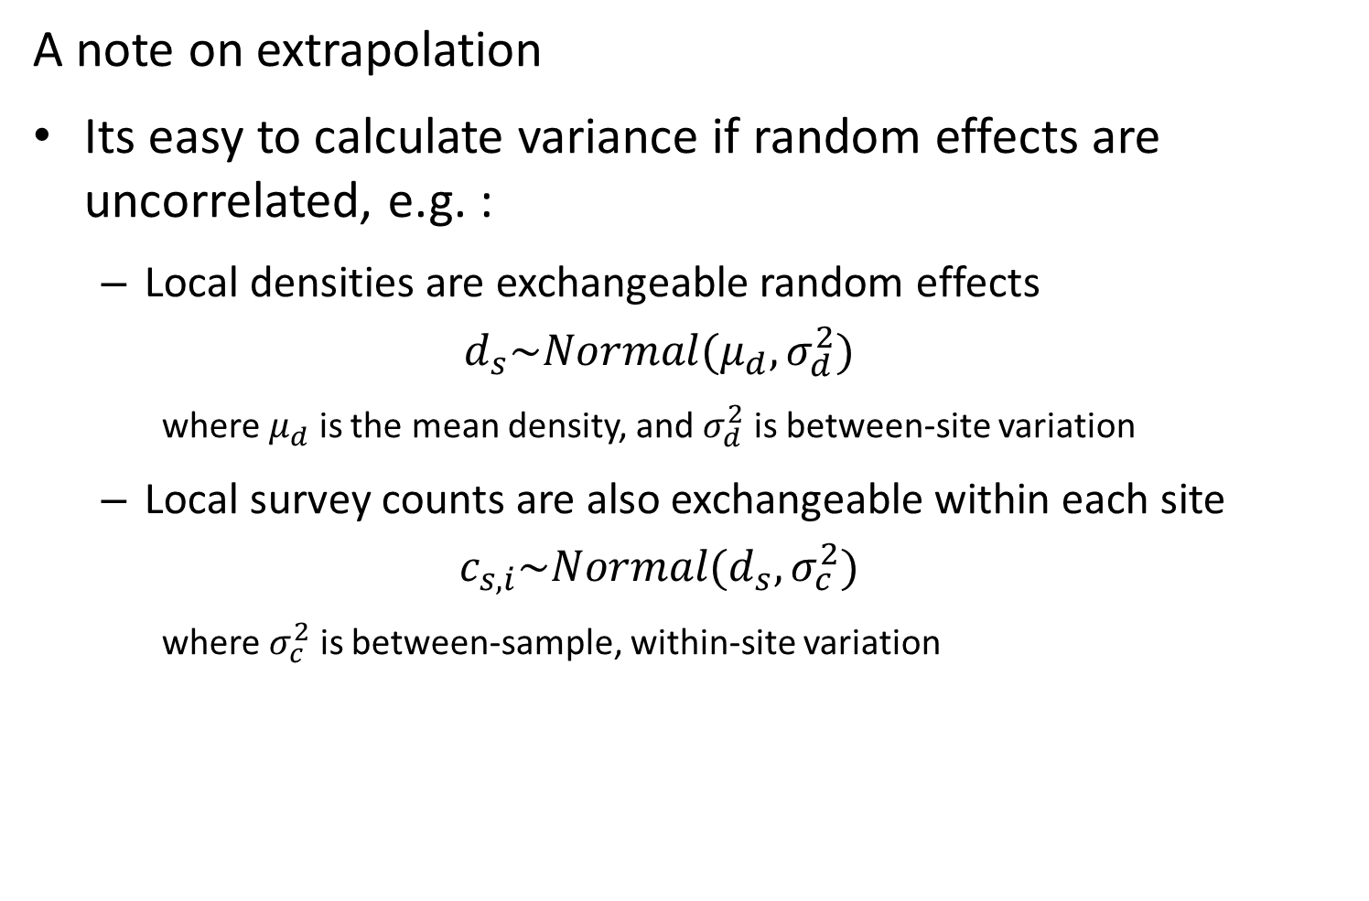
A note on extrapolation
Its easy to calculate variance if random effects are uncorrelated, e.g. :
Local densities are exchangeable random effects
$$d_{s}\sim Normal(μ_{d},σ_{d}^{2})$$
where $μ_{d}$ is the mean density, and $σ_{d}^{2}$ is between-site variation
Local survey counts are also exchangeable within each site
$$c_{s,i}\sim Normal(d_{s},σ_{c}^{2})$$
where $σ_{c}^{2}$ is between-sample, within-site variation

Slide 15
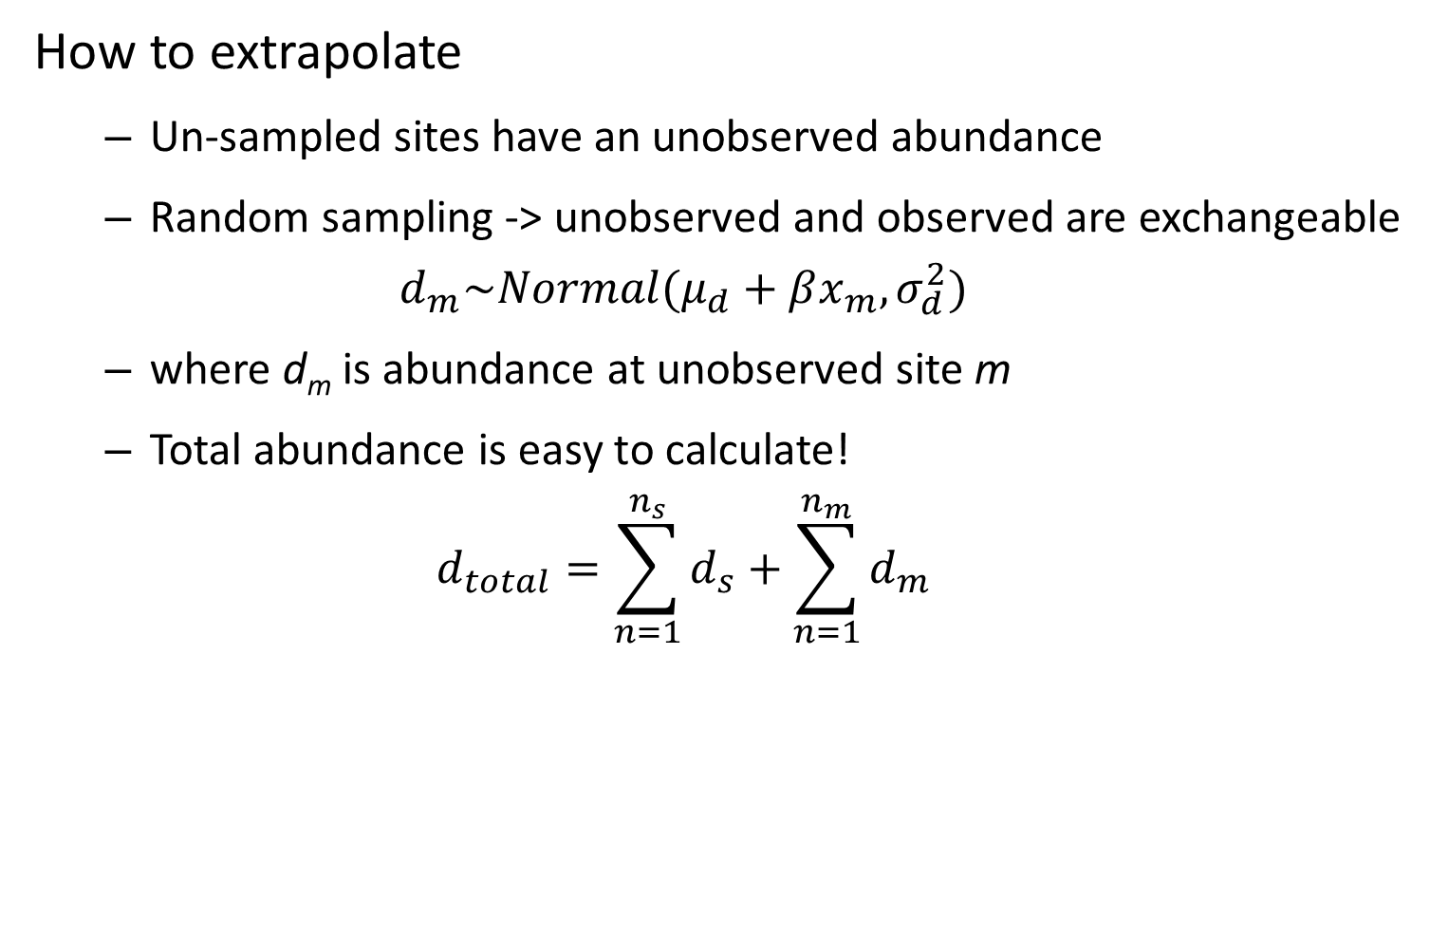
How to extrapolate
Un-sampled sites have an unobserved abundance
Random sampling -> unobserved and observed are exchangeable
$$d_{m}\sim Normal(μ_{d}+βx_{m},σ_{d}^{2})$$
where d_{m} is abundance at unobserved site m
Total abundance is easy to calculate!
$$d_{total}=\sum_{n=1}^{n_{s}}{d_{s}}+\sum_{n=1}^{n_{m}}{d_{m}}$$

Slide 16
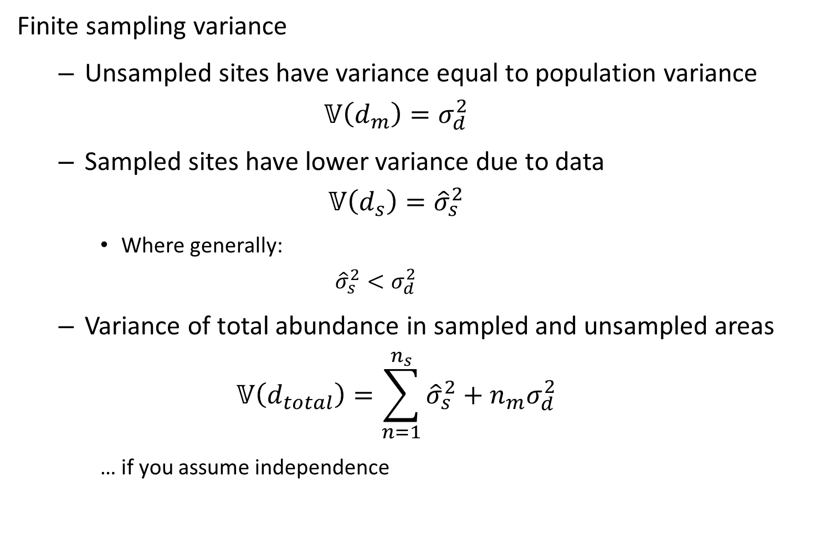
Finite sampling variance
Unsampled sites have variance equal to population variance
$$𝕍\left(d_{m}\right)=σ_{d}^{2}$$
Sampled sites have lower variance due to data
$$𝕍\left(d_{s}\right)={\hat{σ}}_{s}^{2}$$
Where generally:
$${\hat{σ}}_{s}^{2}<σ_{d}^{2}$$
Variance of total abundance in sampled and unsampled areas
$$𝕍\left(d_{total}\right)=\sum_{n=1}^{n_{s}}{{\hat{σ}}_{s}^{2}}+n_{m}σ_{d}^{2}$$
… if you assume independence
Notes:
Perfectly observe the value of something at a specific site
Ones measured are not random variables
Calculate known data and add to the unsampled stuff

Slide 17
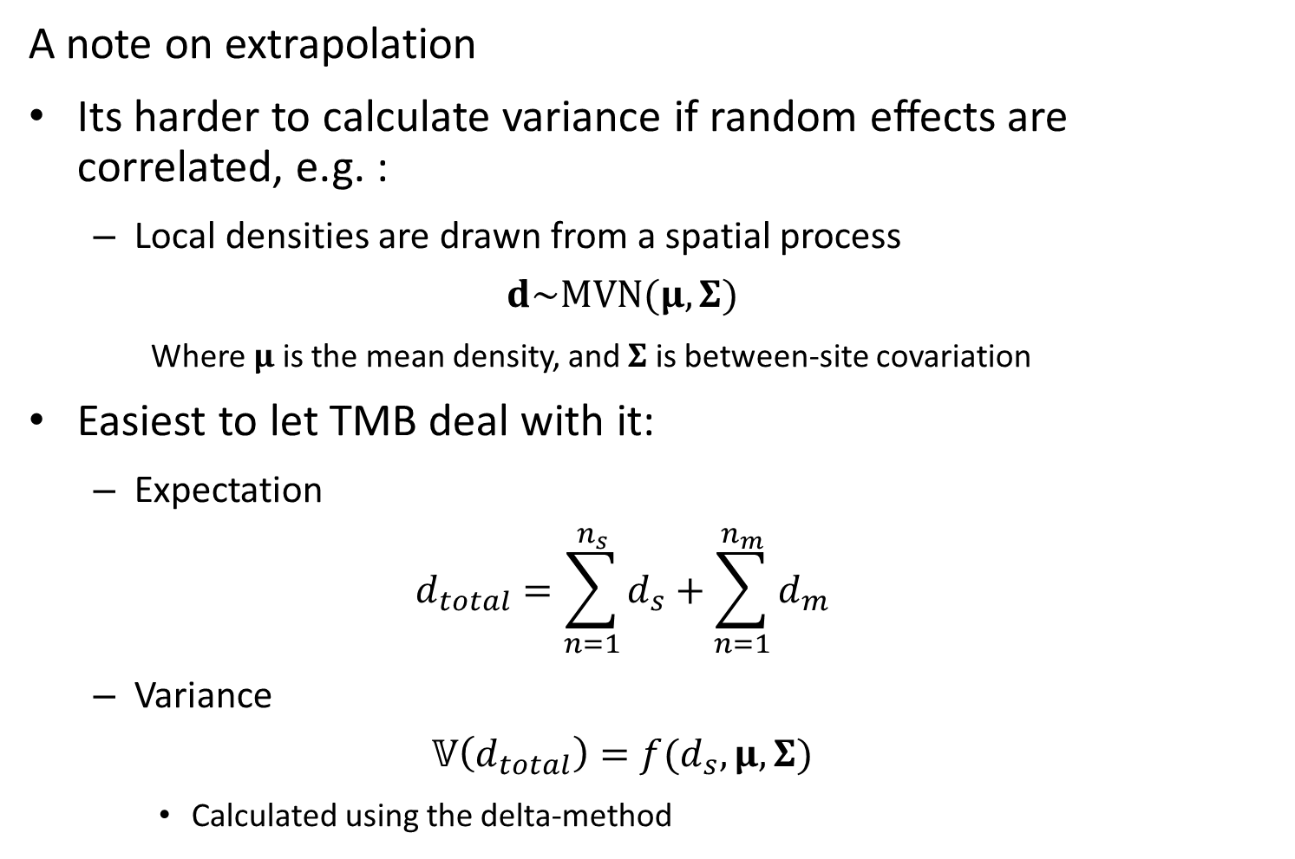
A note on extrapolation
Its harder to calculate variance if random effects are correlated, e.g. :
Local densities are drawn from a spatial process
$$d\sim MVN(μ,Σ)$$
Where $μ$ is the mean density, and $Σ$ is between-site covariation
Easiest to let TMB deal with it:
Expectation
$$d_{total}=\sum_{n=1}^{n_{s}}{d_{s}}+\sum_{n=1}^{n_{m}}{d_{m}}$$
Variance
$$𝕍\left(d_{total}\right)=f(d_{s},μ,Σ)$$
Calculated using the delta-method
Notes:
Let tmb use taylor series, or use posterior draws to get around taylor series appx thereof
More next week on re-transformation bias

